Slide 1
Digital Image Processing
Associate Prof. Zhang Qingfeng(张庆丰)
Department of Computer Science, Jinan University
Office Room: 410, Nanhailou Building
Email: zqf135@qq.com

Slide 2
Chapter 6
Color Image Processing

Slide 3
Original image
Smoothing image
Sharpening image
Low-pass filtering
3
FT Spectrum
High-pass filtering

Slide 4
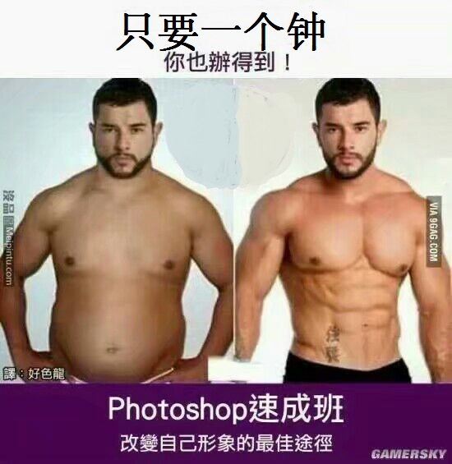
4

Slide 5
Contents
1、Color Fundamentals
2、Color Models
3、Convert Color to Grey
4、Pseudocolor Image Processing
(Convert Grey to Color )
5、Full-color Image Processing
6、Summary
5

Slide 6
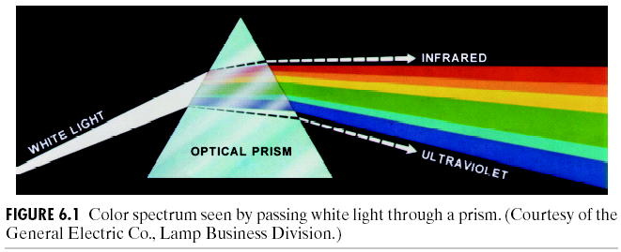
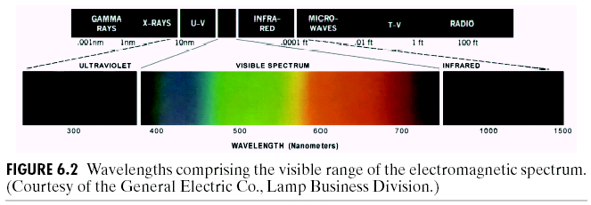
1、Color Fundamentals
The nature of light and colors
Light: from violet to red
Color spectrum – violet, blue, green, yellow, red
6

Slide 7
1、Color Fundamentals
The nature of light and colors (Cnt’d)
Quality of a chromatic light source
radiance (辐射度) – energy flowed
luminance (光通量) – energy received
brightness (亮度) – subjective descriptor of intensity
Primary colors of light
red (R), green (G), blue (B)
consistent with color perception of human eyes
Any color can be created by combing RGB?
7

Slide 8
1、Color Fundamentals
Secondary colors of light
magenta (品红、洋红) (red+blue), cyan（青色） (green+blue), yellow (red+green)
Primary and secondary colors of pigments (颜料)
primary : magenta, cyan, yellow
secondary : red (R), green (G), blue (B)
Difference between primary colors of
light :
additive nature, example: color TV
pigment :
subtractive nature, example: color printing
8

Slide 9
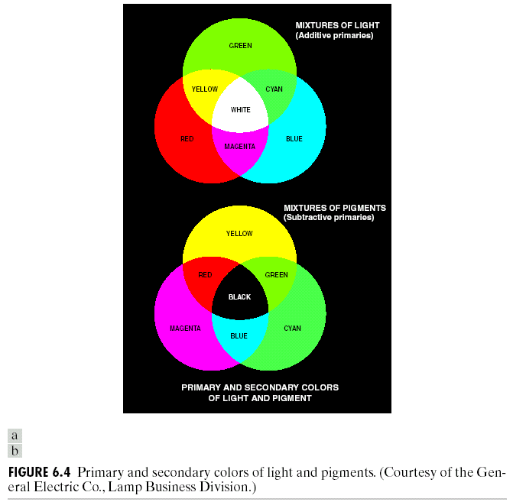
1、Color Fundamentals
9

Slide 10
1、Color Fundamentals
Color characteristics
brightness (亮度): chromatic notion of intensity
hue (色调) : dominant wavelength
saturation (饱和度) : relative purity or white mixed
example:
pink (red + white), lavender (violet + white)
chromaticity (色度) : hue + saturation
10

Slide 11
1、Color Fundamentals
The nature of light and colors (Cnt’d)
Tristimulus values and trichromatic coefficients
tristimulus values (三色激励值): X, Y, Z
trichromatic coefficients (三色系数): x, y, z
11

Slide 12
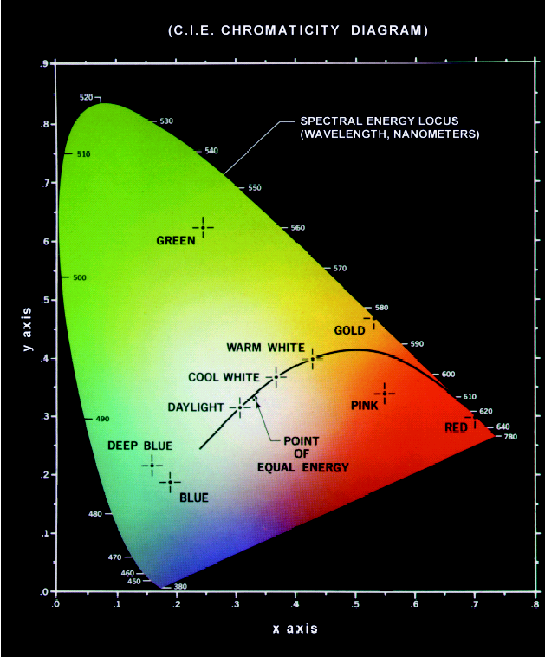
1、Color Fundamentals
CIE Chromaticity Diagram
for specifying colors
boundary : spectrum colors!
color mixing:
a straight-line segment jointing any two points can generate different color variations by combining these two colors additively
Extension to three colors
12

Slide 13
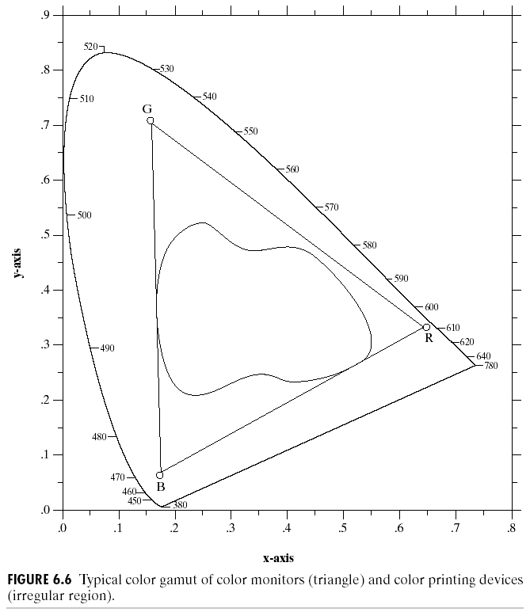
1、Color Fundamentals
The combination of RGB cannot generate all colors!
13

Slide 14
2、Color Models
Purpose of color models
Facilitate the specification of colors in some standard, generally accepted way.
Categorization
Hardware-oriented (color monitors and printers)
RGB : color monitors and color video cameras
CMY (cyan, magenta, yellow) or CMYK (cyan, magenta, yellow, black) : color printing
Application-oriented (color manipulation)
HSI (hue, saturation, intensity )
color and gray-scale information are decoupled;
many gray-scale techniques can be used!
14

Slide 15
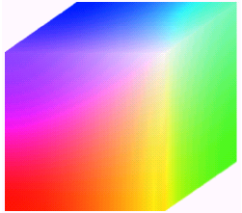
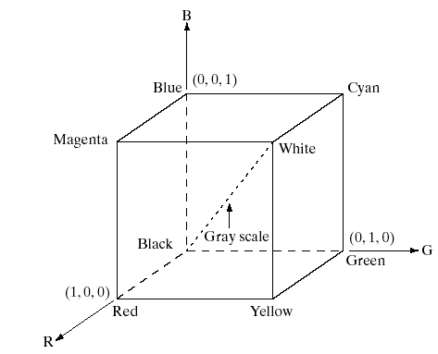
2、Color Models
The RGB color model
Three image planes, each usually 8-bit per pixel
Full-color: 24-bit RGB color image, representing (2⁸)³ colors!
15

Slide 16
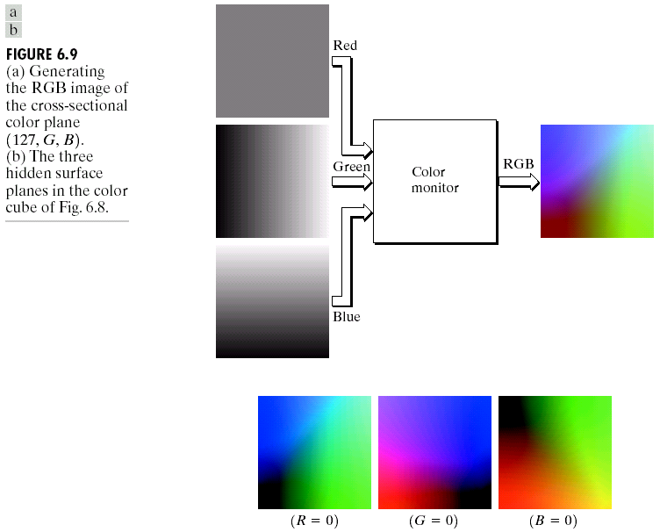
2、Color Models
16

Slide 17
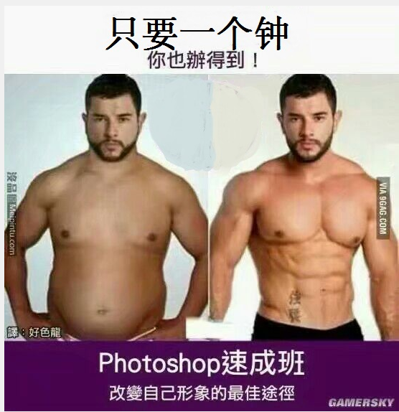
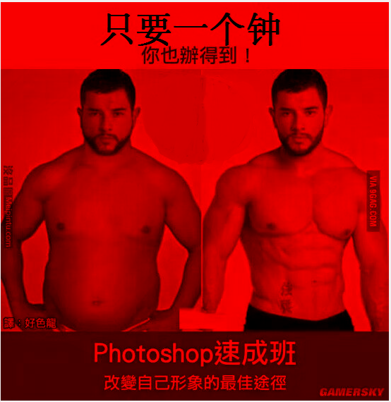
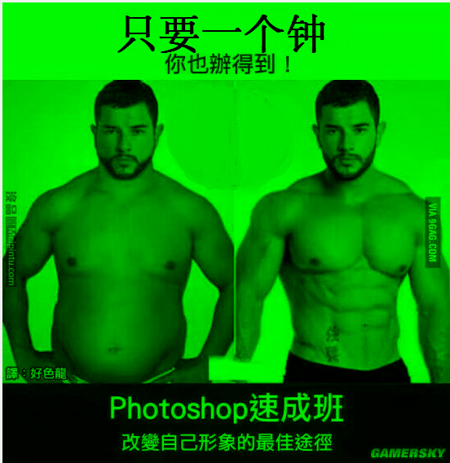
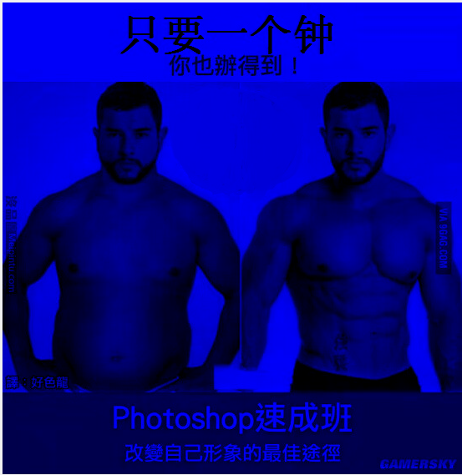
2、Color Models
a)
b)
One image and its RGB components.
Original
Red component
Green component
Blue Component
d)
c)
17

Slide 18
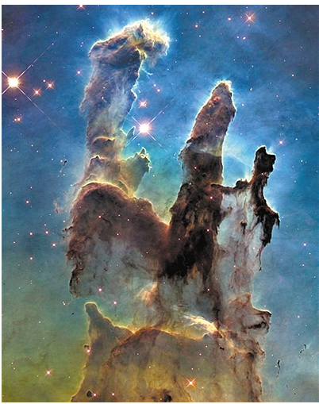
2、Color Models
Fig. Pillars of Creation. Taken by HST in 1995年，M16(老鹰星云) and its cold gas pillars。
18

Slide 19
2、Color Models
The CMY and CMYK color model
Most devices that deposit colored pigments on paper require CMY input or perform an RGB to CMY conversion:
Why CMYK model?
Black can be generated by equally combining CMY, while it is muddy-looking!
Fourth color, black, is added to CMY
19

Slide 20
2、Color Models
The HSI color model
Problems with the RGB and the CMY/CMYK models.
not well suited for human interpretation! We cannot identify the percentage of composite colors.
HSI (hue, saturation, intensity) is better
natural and intuitive to human interpretation
decouple intensity component from color-carrying information (hue and saturation)
ideal tool for developing image processing algorithms
20

Slide 21
2、Color Models
Converting colors from RGB to HIS
21

Slide 22
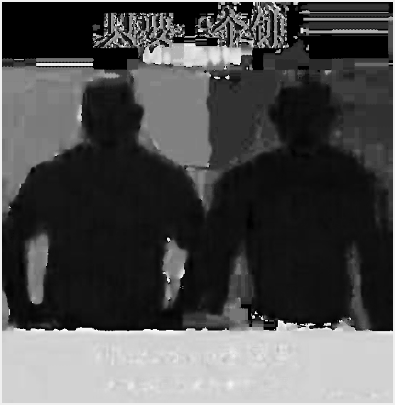
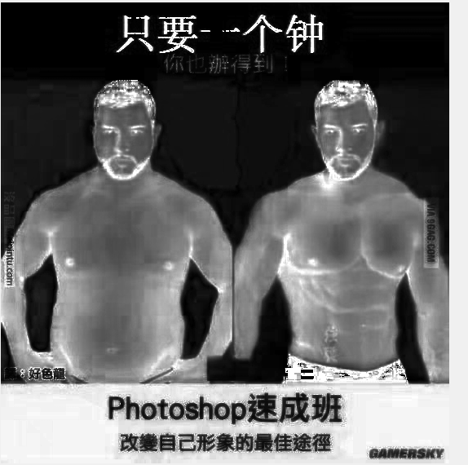
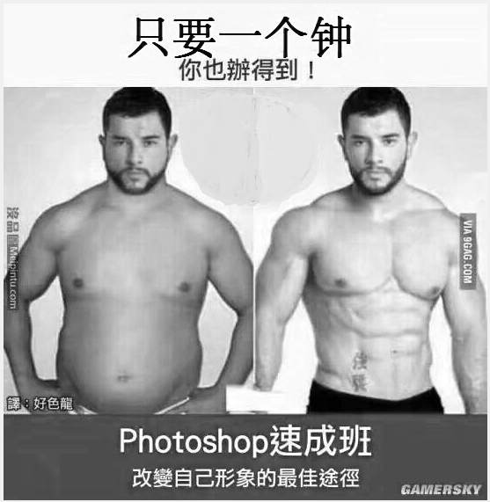
3、Convert Color to Grey
a)
Original
hue image
saturation image
Intensity image
b)
d)
c)
22

Slide 23
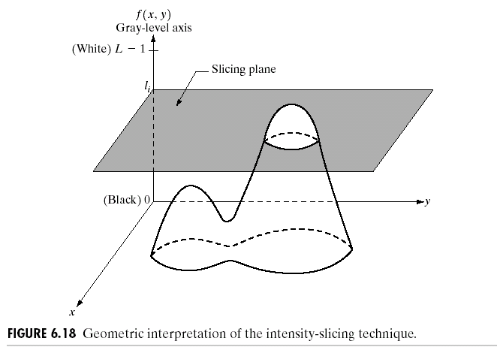
4、Pseudocolor Image Processing
Purpose
For human visualization and interpretation of gray-scale events in an image or sequence of images.
Human can discern:
thousands of colors vs. only two dozen gray levels
Intensity slicing
23

Slide 24
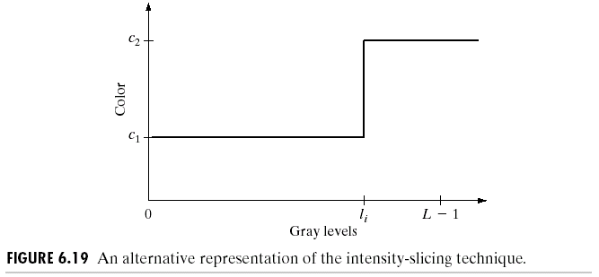
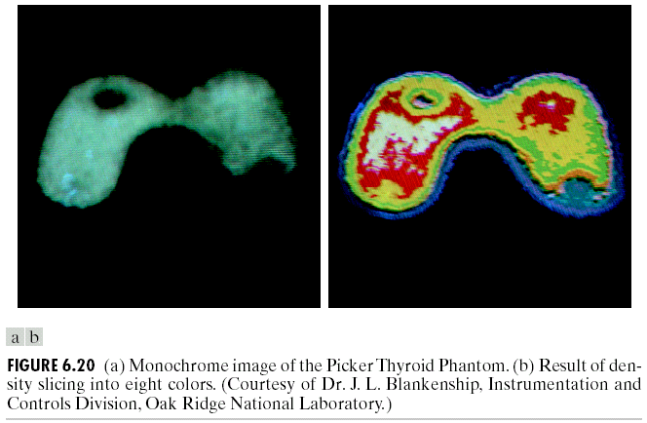
4、Pseudocolor Image Processing
24

Slide 25
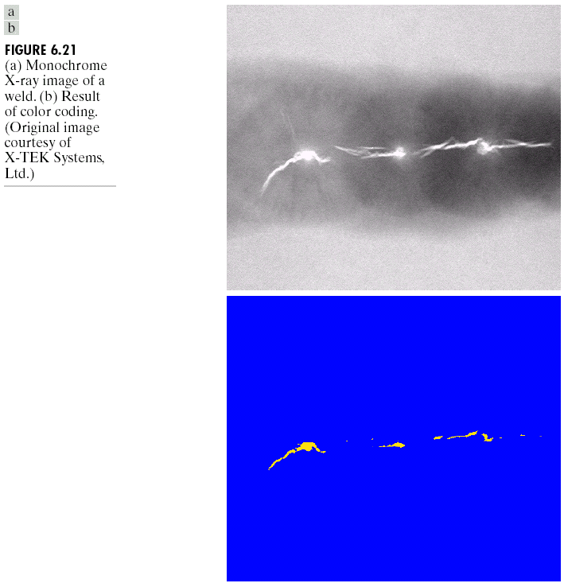
4、Pseudocolor Image Processing
25

Slide 26
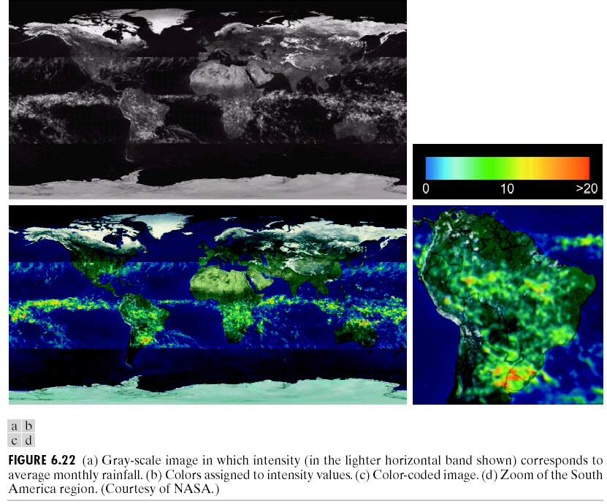
4、Pseudocolor Image Processing
26

Slide 27
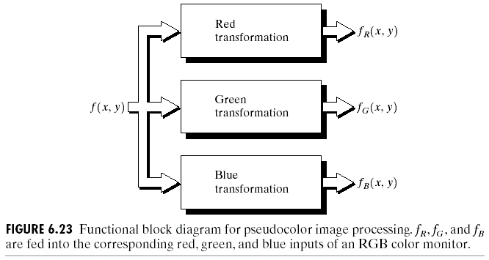
4、Pseudocolor Image Processing
Gray level to color transformations
For single image
three independent transformations on gray levels
final colors are determined by the transformations
27

Slide 28
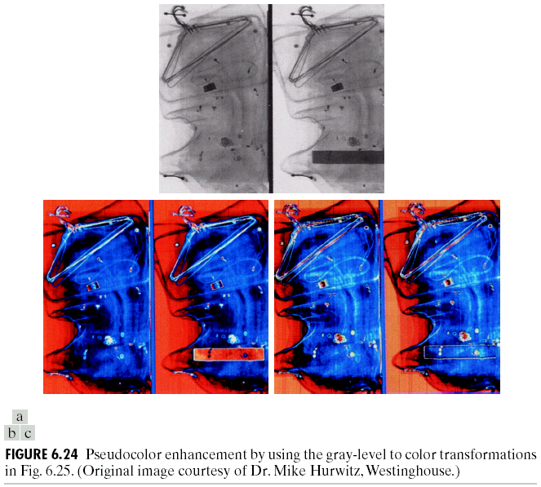
4、Pseudocolor Image Processing
Gray level to color transformations
28

Slide 29
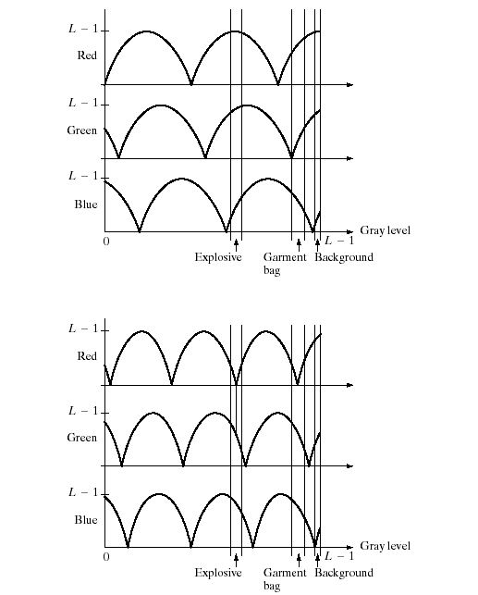
4、Pseudocolor Image Processing
29

Slide 30
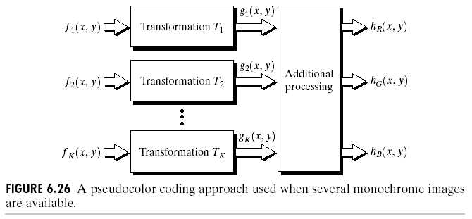
4、Pseudocolor Image Processing
Gray level to color transformations
For multiple images (especially for multispectral images)
Knowledge on the response characteristics of the sensors is important for combining the images!
30

Slide 31
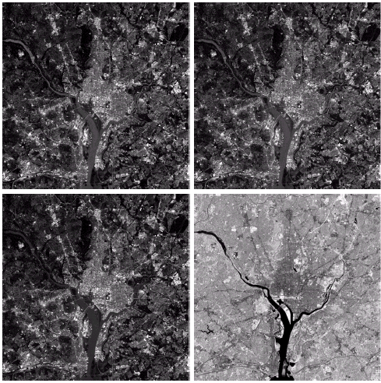
4、Pseudocolor Image Processing
31

Slide 32
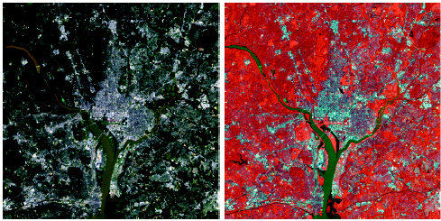
4、Pseudocolor Image Processing
32

Slide 33
5、Full-color Image Processing
Major categories for full-color image processing
First category:
process each component image individually, and then form a composite processed color image from the individually processed components
Second category:
work with color pixels directly
Major considerations – vector-based processing
33

Slide 34
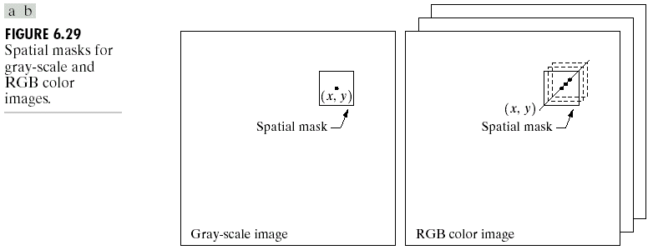
5、Full-color Image Processing
Major considerations – vector-based processing (Cnt’d)
approaches?
34

Slide 35
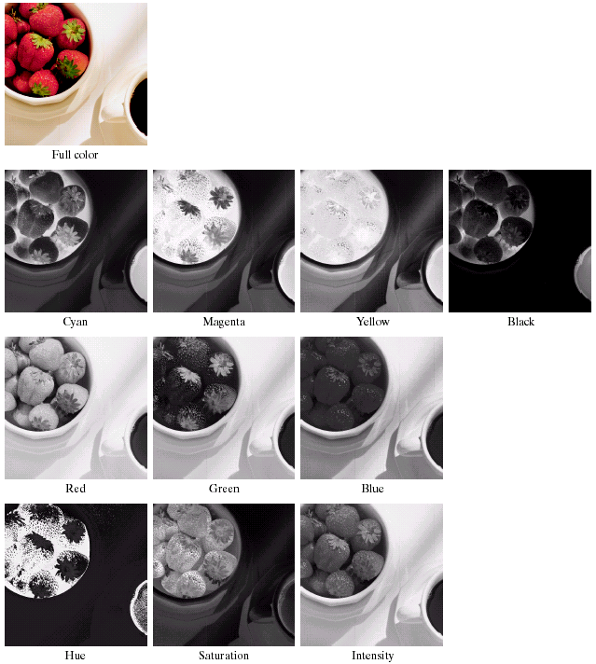
5、Full-color Image Processing
Example:
Color components
35

Slide 36
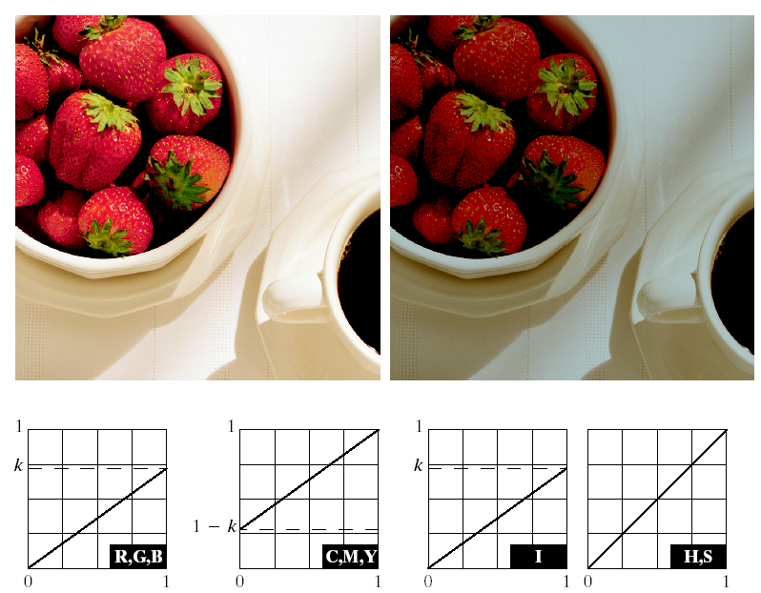
5、Full-color Image Processing
Example:
Adjusting the intensity of an image
36

Slide 37
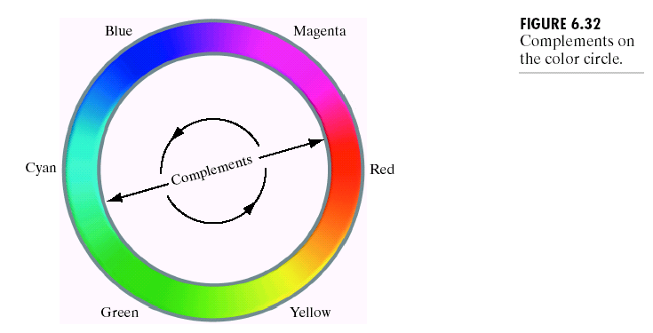
5、Full-color Image Processing
Color complements
color circle
the hues directly opposite one another on the color circle are called complements
37

Slide 38
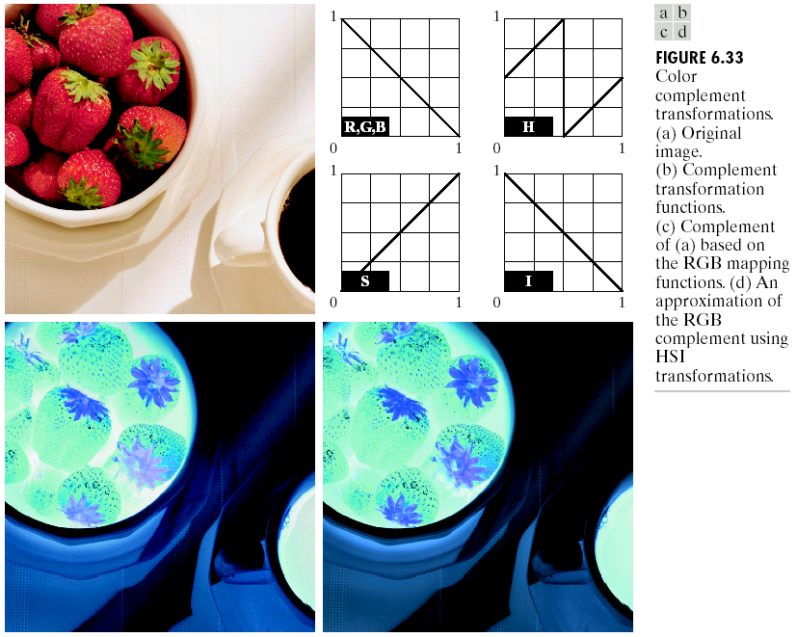
5、Full-color Image Processing
Color complements
38

Slide 39
5、Full-color Image Processing
Color slicing
purpose
display the colors of interest so that they stand out from the background;
use the region defined by the colors as a mask for further processing
approaches
colors of interest are enclosed by a cube
39

Slide 40
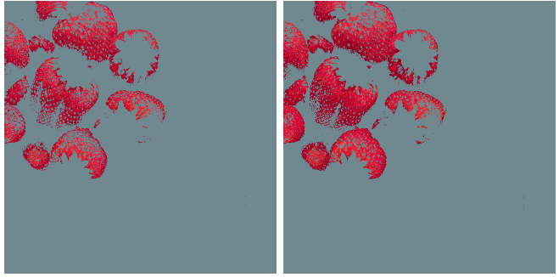
5、Full-color Image Processing
approaches (Cnt’d)
colors of interest are enclosed by a sphere
40

Slide 41
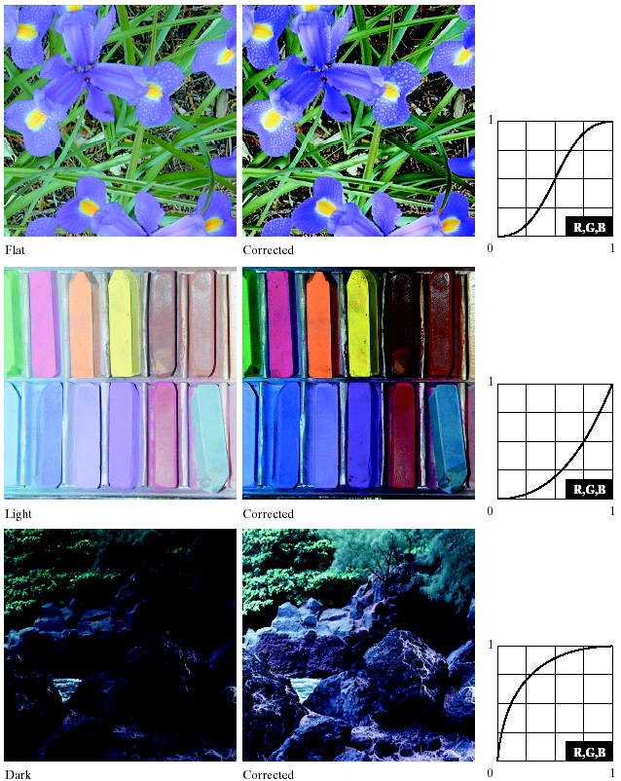
5、Full-color Image Processing
Tone and color corrections
tonal corrections
41

Slide 42
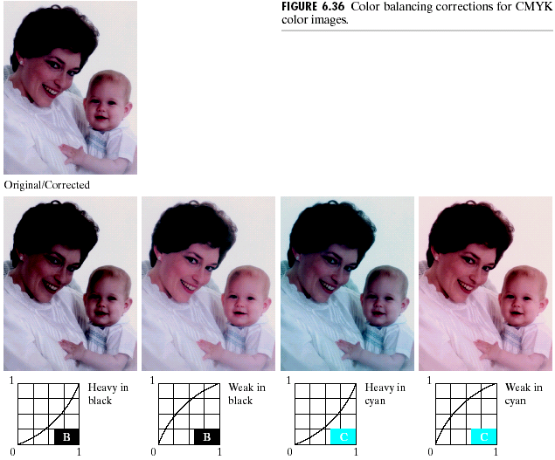
5、Full-color Image Processing
Tone and color corrections
tonal corrections
42

Slide 43
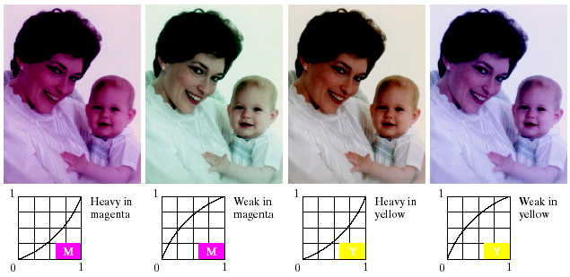
5、Full-color Image Processing
Tone and color corrections
color balancing
43

Slide 44
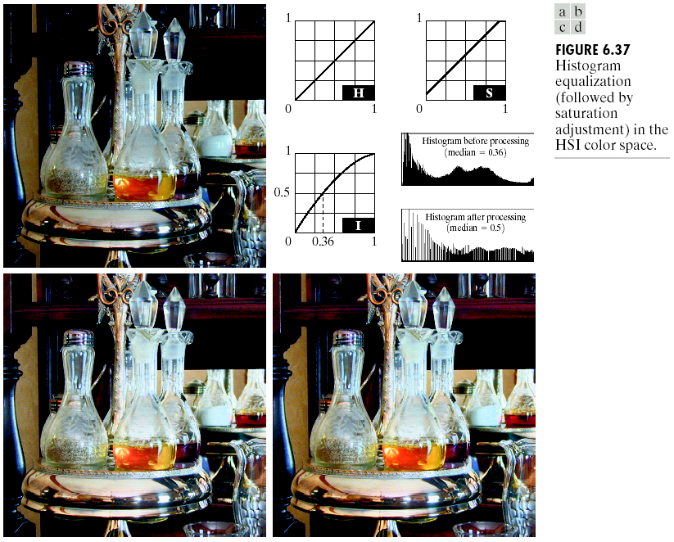
5、Full-color Image Processing
Histogram processing
Spread the color intensities uniformly, leaving the colors themselves (e.g. hues) unchanged!
44

Slide 45
5、Full-color Image Processing
Color image smoothing
per-color-plane basis
intensity component basis
45

Slide 46
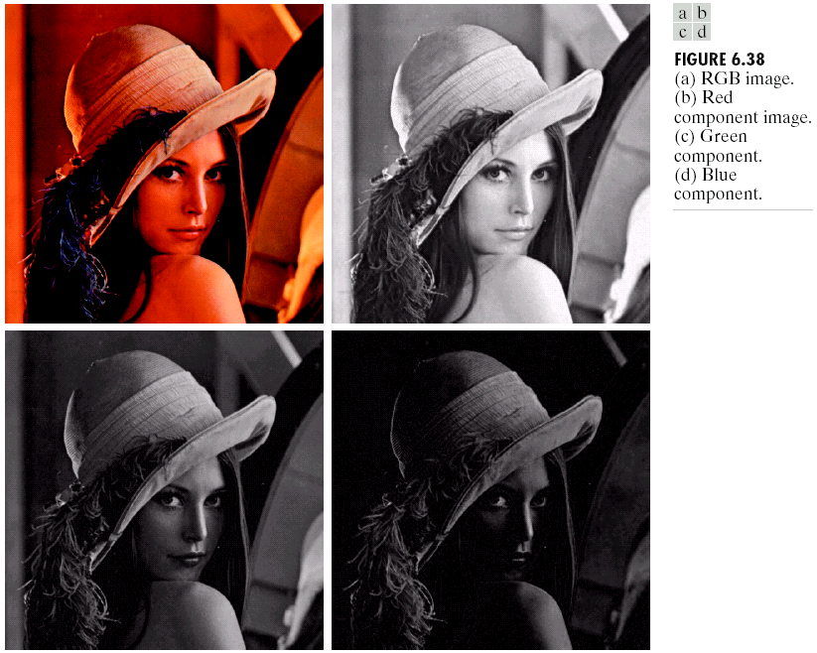
5、Full-color Image Processing
Color image smoothing
46

Slide 47
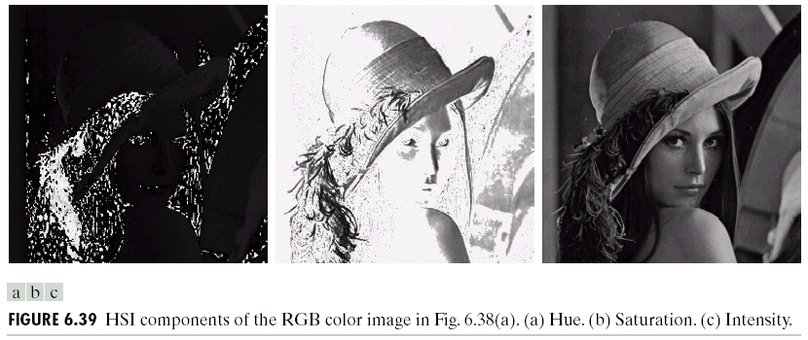
5、Full-color Image Processing
Color image smoothing
47

Slide 48
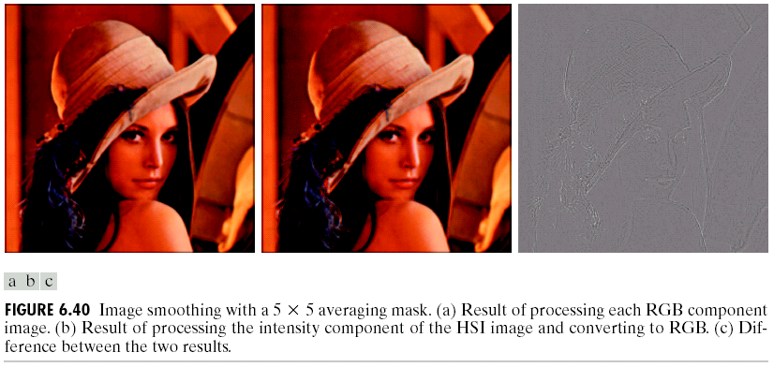
5、Full-color Image Processing
Color image smoothing
48

Slide 49
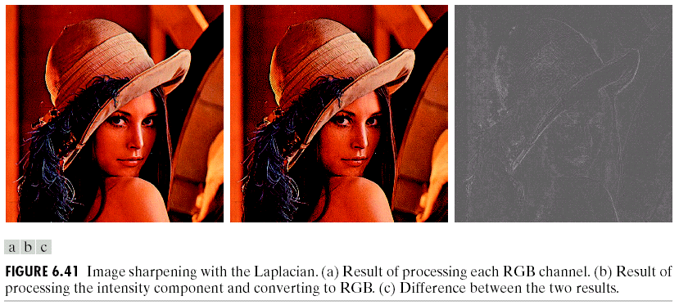
5、Full-color Image Processing
Color image sharpening
Laplacian of color vector:
49

Slide 50
Summary
In this lecture, we have learned
Color Fundamentals
Color Models
Pseudocolor Image Processing
Full Color Image Processing
50

